Slide 1

State of Podman
2022
Dan Walsh - @rhatdan

Slide 2
Please Stand

Slide 3
Please read out loud all text in
RED

Slide 4
I Promise

Slide 5
To say
Make a copy
Rather than
Make a Xerox

Slide 6
I Promise

Slide 7
To say
Tissue
Rather than
Kleenex

Slide 8
I Promise

Slide 9
To say
Container Registries
Rather than
Docker registries

Slide 10
I Promise

Slide 11
To say
Container Images
Rather than
Docker images

Slide 12
I Promise

Slide 13
To say
Containers
Or
OCI Containers
Rather than
Docker Containers

Slide 14
I Promise

Slide 15
To give this presentation a
5 Star review

Slide 16
Sit Down

Slide 17

Dan Quiote

Slide 18

Health of the Podman Project

Slide 19
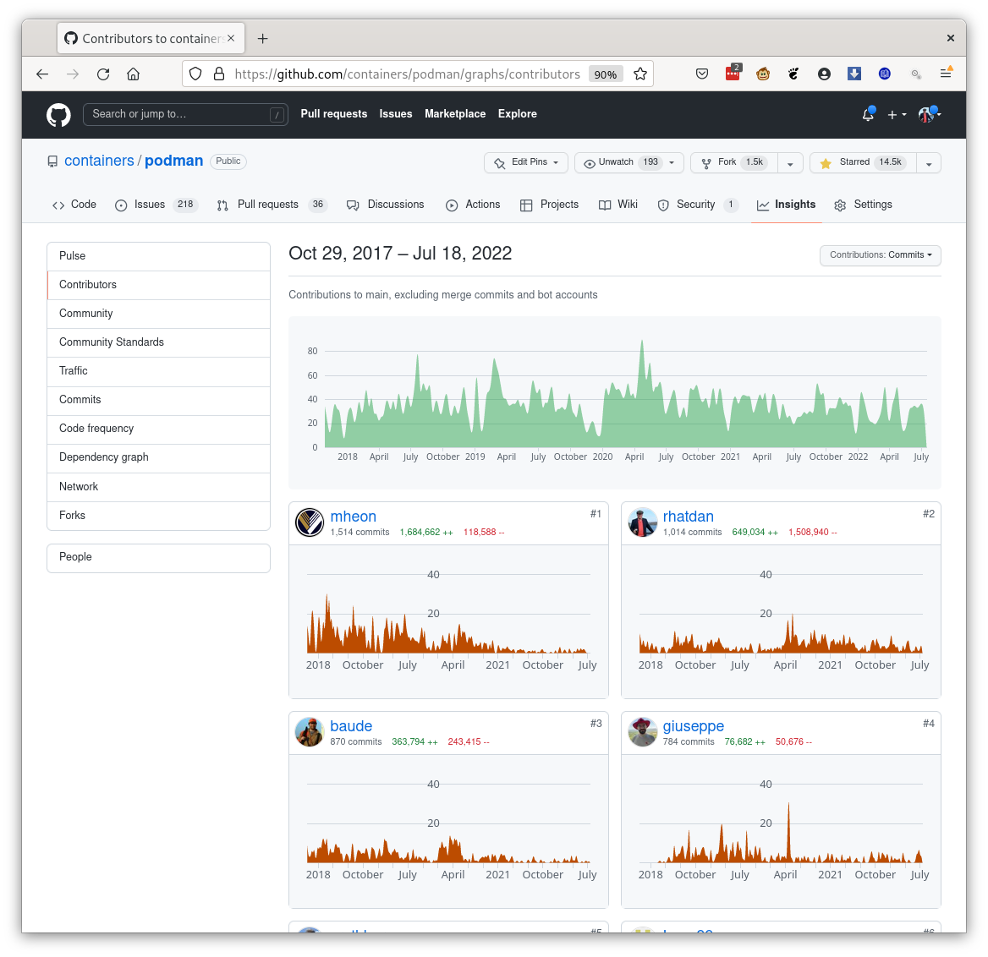

Slide 20


Slide 21
Health of the Podman Project
Statistics since January 1st 2022
 | Podman | Docker(Moby) | containerd | CRI-O
Authors | 122 | 52 | 102 | 44
Commits | 1053 | 678 | 426 | 299
Closed Issues | 1110 | 447 | 489 | 483
Merged PRs | 980 | 356 | 407 | 335
podman.io email list
  ~500 members
  Averaging a couple of message a day, 7 days a week.

Slide 22
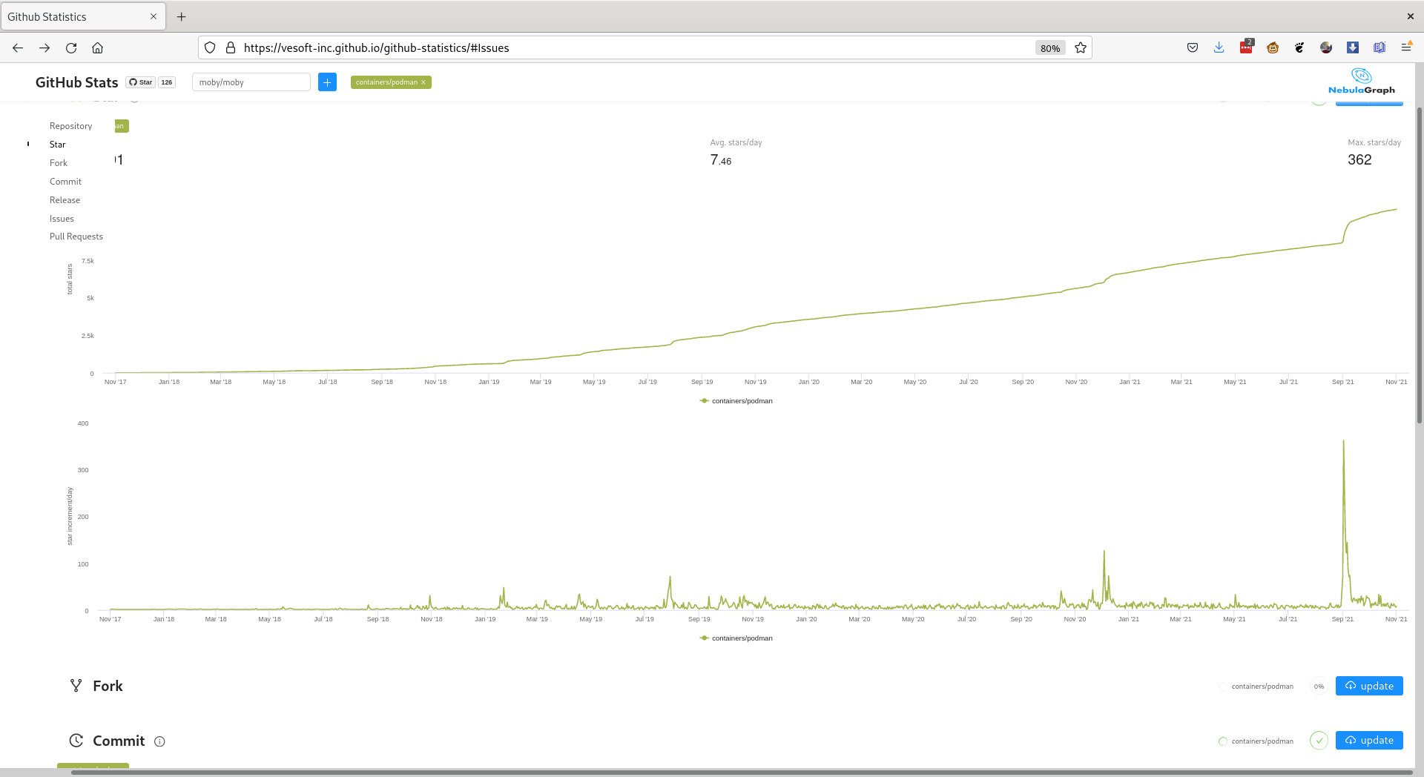

Slide 23
Replacing Docker
With Podman
By Dan Walsh @rhatdan

Slide 24
dnf install -y podman

Slide 25
dnf install -y podman
alias docker=podman

Slide 26

Questions
Blog: https://medium.com/cri-o
Github:
https://github.com/kubernetes-sigs/cri-o
https://github.com/containers/buildah
https://github.com/containers/skopeo
https://github.com/containers/libpod (podman)
https://github.com/containers/storage
https://github.com/containers/image
Site: https://cri-o.io IRC: freenode: #cri-o
Site: https://podman.io IRC: freenode: #podman
Site: https://buildah.io IRC: freenode: #buildah

Slide 27
Dan?
Podman replaced the Docker CLI.
What about the rest of what Docker does?

Slide 28
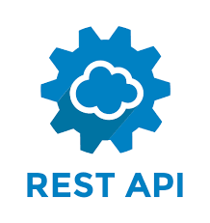
podman system service libpod and compat endpoints
Rest API
podman system service
/v2.0.0/libpod/containers/json
/v2.0.0/containers/json
libpod
compat
libpod
specific
shared code
compat
specific
libpod

Slide 29
podman system service libpod and compat endpoints podman-py https://github.com/containers/podman-py
Contributors welcome!
Rest API
podman system service
/v2.0.0/libpod/containers/json
/v2.0.0/containers/json
libpod
compat
libpod
specific
shared code
compat
specific
libpod

Slide 30
podman system service libpod and compat endpoints podman-py https://github.com/containers/podman-py
Contributors welcome! docker-py
Supported with exceptions to link, Swarm, etc
Tested in upstream CI
Rest API
podman system service
/v2.0.0/libpod/containers/json
/v2.0.0/containers/json
libpod
compat
libpod
specific
shared code
compat
specific
libpod

Slide 31
podman system service libpod and compat endpoints podman-py https://github.com/containers/podman-py
Contributors welcome! docker-py
Supported with exceptions to link, Swarm, etc
Tested in upstream CI compose
Rootfull and rootless support
Tested in upstream CI podman container rename command https://www.redhat.com/sysadmin/compose-kubernetes-podman
Rest API
podman system service
/v2.0.0/libpod/containers/json
/v2.0.0/containers/json
libpod
compat
libpod
specific
shared code
compat
specific
libpod

Slide 32
podman system service libpod and compat endpoints podman-py https://github.com/containers/podman-py
Contributors welcome! docker-py
Supported with exceptions to link, Swarm, etc
Tested in upstream CI compose
Rootfull and rootless support
Tested in upstream CI podman container rename command https://www.redhat.com/sysadmin/compose-kubernetes-podman
Full support for the API within Gitlab Runners 2022-07-14 https://gitlab.com/gitlab-org/gitlab-runner/-/issues/27119
Rest API
podman system service
/v2.0.0/libpod/containers/json
/v2.0.0/containers/json
libpod
compat
libpod
specific
shared code
compat
specific
libpod

Slide 33


Slide 34
podman --remote
Podman client talks to Podman service to launch containers.

Slide 35
podman --remote
Podman client talks to Podman service to launch containers.
podman system connection
Configure SSH connections to Podman service running on Linux machines

Slide 36
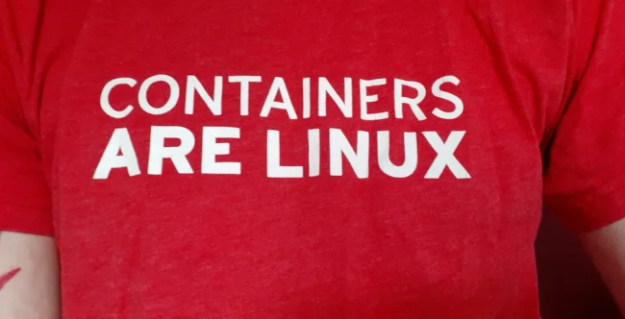

Slide 37


Podman Machine
Podman machine
  Set of commands to manage Podman's virtual machine on macOS.
  Default OS Fedora CoreOS
  Simple commands
  Rootless and rootfull
  Automatically configure ssh connections

Slide 38
Podman on a MAC
Podman machine
  Set of commands to manage Podman's virtual machine on macOS.
  Default OS Fedora CoreOS
  Simple commands
  Rootless and rootfull
  Automatically configure ssh connections

Slide 39
Podman on a MAC
Podman machine
  Set of commands to manage Podman's virtual machine on macOS.
  Default OS Fedora CoreOS
  Simple commands
  Rootless and rootfull
  Automatically configure ssh connections
On Mac
$ brew install podman
$ podman machine init
$ podman run ubi8 echo hi

Slide 40
Podman on a MAC
Podman machine
  Set of commands to manage Podman's virtual machine on macOS.
  Default OS Fedora CoreOS
  Simple commands
  Rootless and rootfull
  Automatically configure ssh connections
On Mac
$ brew install podman
$ podman machine init
$ podman run ubi8 echo hi
Native installer being developed

Slide 41

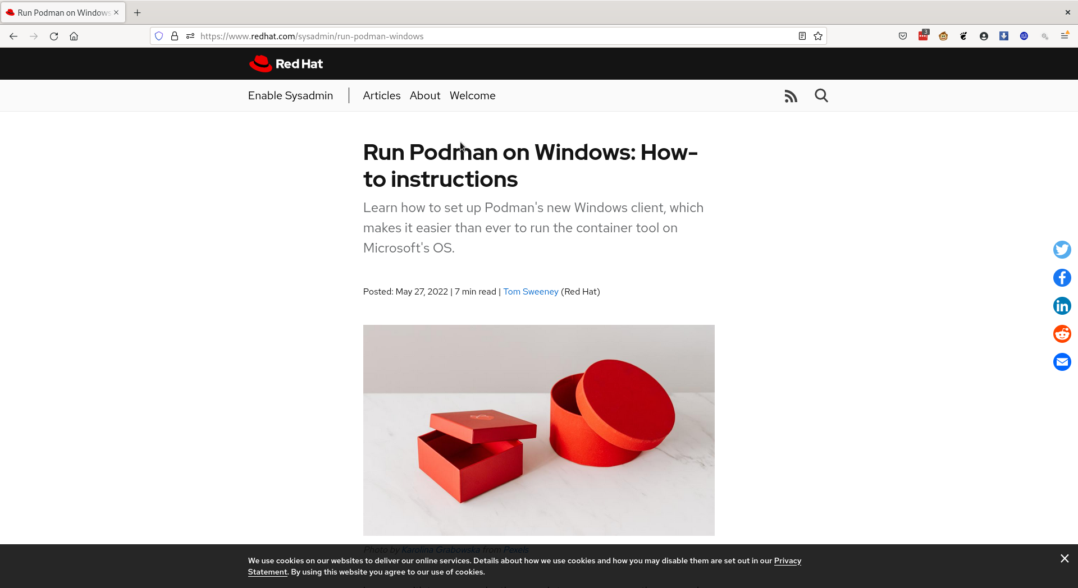
Podman on Windows
Based on WSL2

Slide 42
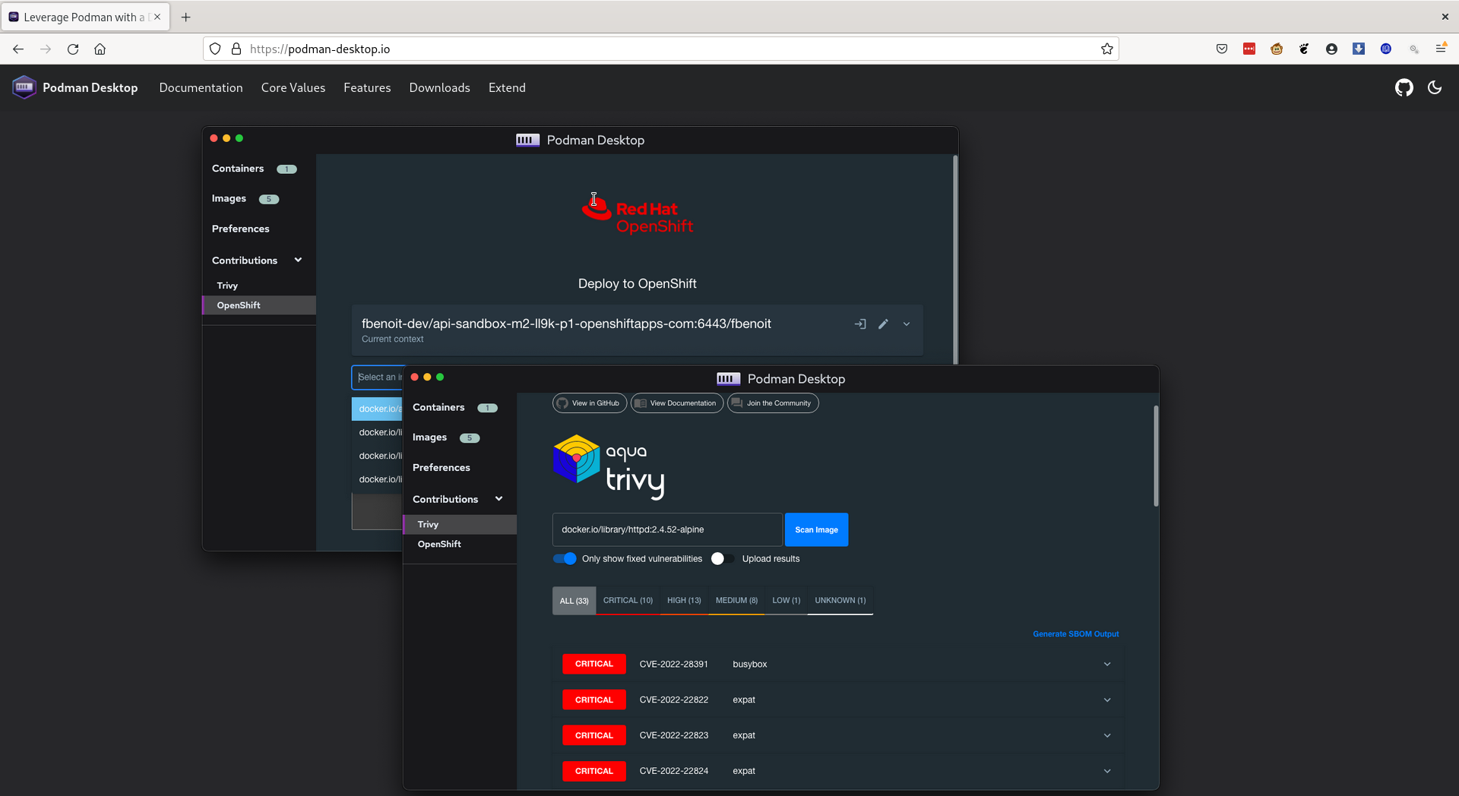
Podman Desktop

Slide 43

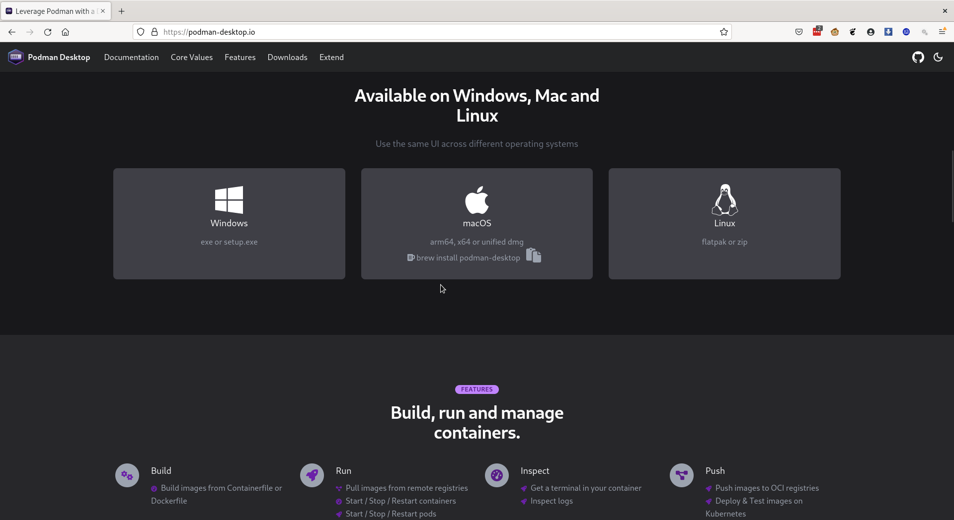
Podman Desktop

Slide 44


Slide 45
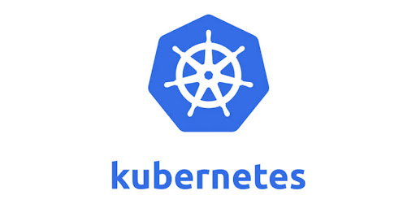

Slide 46
Podman play kube improvements
Goal is to make kubernetes.yaml viable replacement for docker-compose.
Kubernetes won the container orchestrator battle

Slide 47
Podman play kube improvements
Goal is to make kubernetes.yaml viable replacement for docker-compose.
Kubernetes won the container orchestrator battle
Easier to migrate to/from Kubernetes
  podman generate kube
  podman play kube

Slide 48
Podman play kube improvements
Goal is to make kubernetes.yaml viable replacement for docker-compose.
Kubernetes won the container orchestrator battle
Easier to migrate to/from Kubernetes
Add compose features to podman play kube:
Build images via Containerfile/Dockerfile before running kube
  podman play kube --build

Slide 49
Podman play kube improvements
Goal is to make kubernetes.yaml viable replacement for docker-compose.
Kubernetes won the container orchestrator battle
Easier to migrate to/from Kubernetes
Add compose features to podman play kube:
Build images via Containerfile/Dockerfile before running kube
  podman play kube --build
Start and stop local kube.yaml based application
  podman play kube / podman play kube --down

Slide 50
Podman play kube improvements
Kubernetes features
Init containers

Slide 51
Podman play kube improvements
Kubernetes features
Init containers
HealthCheck: K8s equivalent liveness probe

Slide 52
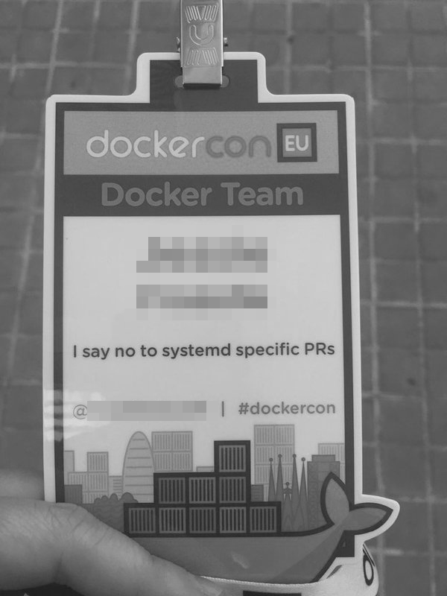
Docker Inc was proud to say they rejected all Systemd PRs.

Slide 53
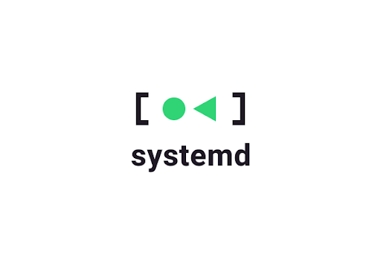
Docker Inc was proud to say they rejected all Systemd PRs.
Podman is proud to say it embraces the power of systemd.

Slide 54
Podman Integration with Systemd
Podman treats systemd as a first class partner
  systemd as pid1 of container supported by default

Slide 55
Podman Integration with Systemd
Podman treats systemd as a first class partner
  systemd as pid1 of container supported by default
Generate systemd services (unit files) from pods/containers

Slide 56
Podman Integration with Systemd
Podman treats systemd as a first class partner
  systemd as pid1 of container supported by default
Generate systemd services (unit files) from pods/containers
Supports socket activated containers

Slide 57
Podman Integration with Systemd
Podman treats systemd as a first class partner
  systemd as pid1 of container supported by default
Generate systemd services (unit files) from pods/containers
Supports socket activated containers
Supports sd-notify containers

Slide 58
Podman Integration with Systemd
Podman treats systemd as a first class partner
  systemd as pid1 of container supported by default
Generate systemd services (unit files) from pods/containers
Supports socket activated containers
Supports sd-notify containers
podman auto-update (edge)

Slide 59
Podman Integration with Systemd
Podman treats systemd as a first class partner
  systemd as pid1 of container supported by default
Generate systemd services (unit files) from pods/containers
Supports socket activated containers
Supports sd-notify containers
podman auto-update (edge)
Podman auto-update rollback support

Slide 60
Podman Integration with Systemd
Podman treats systemd as a first class partner
  systemd as pid1 of container supported by default
Generate systemd services (unit files) from pods/containers
Supports socket activated containers
Supports sd-notify containers
podman auto-update (edge)
Podman auto-update rollback support
Podman restart service

Slide 61
Podman Integration with Systemd
Podman treats systemd as a first class partner
  systemd as pid1 of container supported by default
Generate systemd services (unit files) from pods/containers
Supports socket activated containers
Supports sd-notify containers
podman auto-update (edge)
Podman auto-update rollback support
Podman restart service
Support for quadlet

Slide 62

What’s Next?

Slide 63
Podman on the Edge
Perfect tool for running containerized applications on edge devices.
Define your containerized application as kubernetes.YAML

Slide 64
Podman on the Edge
Perfect tool for running containerized applications on edge devices.
Define your containerized application as kubernetes.YAML
Build and test application using OpenShift/Kubernetes

Slide 65
Podman on the Edge
Perfect tool for running containerized applications on edge devices.
Define your containerized application as kubernetes.YAML
Build and test application using OpenShift/Kubernetes
Deploy using Podman on RHEL CoreOS for Edge

Slide 66
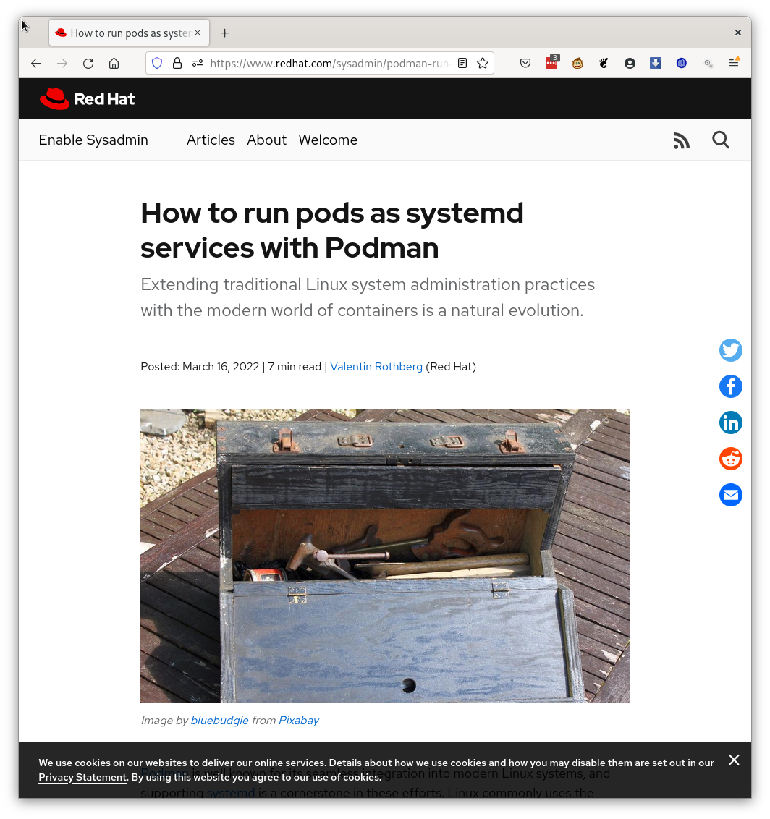
Podman Kubernetes.Yaml with SystemD Units https://www.redhat.com/sysadmin/podman-run-pods-systemd-services

Slide 67
Podman on the Edge
Perfect tool for running containerized applications on edge devices.
Define your containerized application as kubernetes.YAML
Build and test application using OpenShift/Kubernetes
Deploy using Podman on RHEL CoreOS for Edge
No overhead while containerized applications are running

Slide 68
Podman on the Edge
Perfect tool for running containerized applications on edge devices.
Define your containerized application as kubernetes.YAML
Build and test application using OpenShift/Kubernetes
Deploy using Podman on RHEL CoreOS for Edge
No overhead while containerized applications are running
Systemd manages lifecycle of application
  Podman health checks via SystemD monitor application
  Podman auto update
  If health check fails, Podman roll back

Slide 70

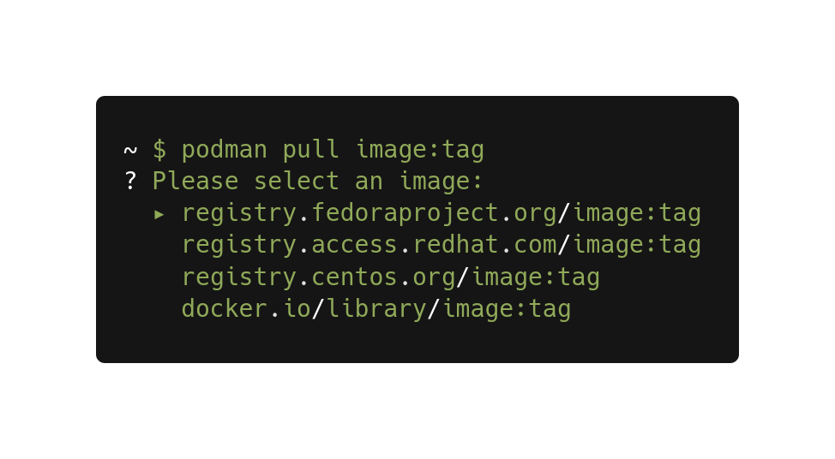
Podman Security
Improved Short-Name Resolution with Podman v3.0

Slide 71
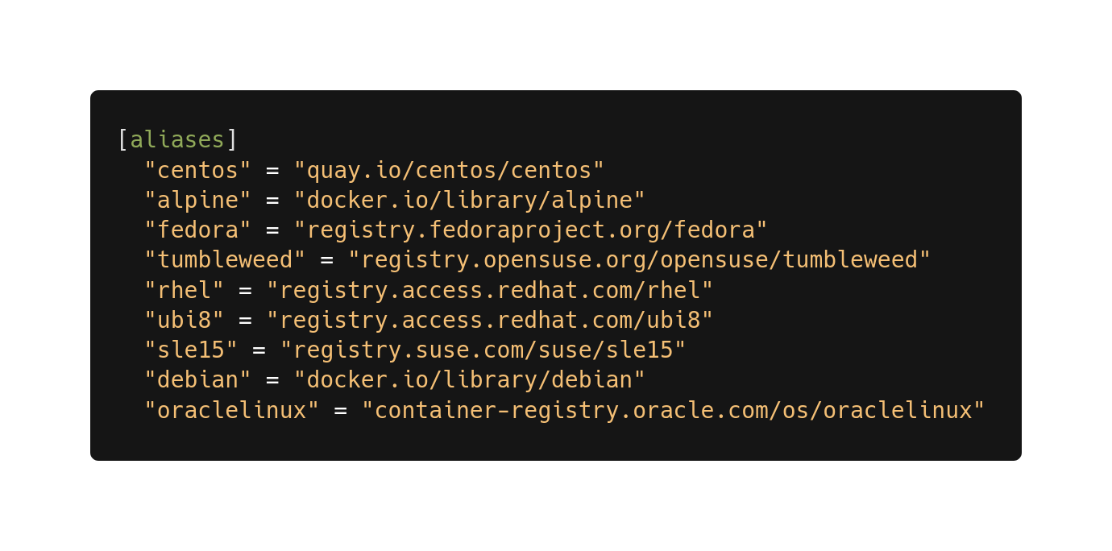
Podman Security
Short-Name Aliasing
github.com/containers/shortnames

Slide 72
Podman Security
Additional Dropped Linux Capabilities
  CAP_AUDIT_WRITE
  CAP_NET_RAW
  CAP_MKNOD

Slide 73
Podman Security
Additional Dropped Linux Capabilities
  CAP_AUDIT_WRITE
  CAP_NET_RAW
  CAP_MKNOD
podman run --security-opt unmask
  Masked paths
    /proc/acpi, /proc/kcore, /proc/keys, /proc/latency_stats, /proc/sched_debug, /proc/scsi, /proc/timer_list, /proc/timer_stats, /sys/firmware, /sys/fs/selinux
  ReadOnly Paths
    /proc/asound, /proc/bus, /proc/fs, /proc/irq, /proc/sys, /proc/sysrq-trigger.

Slide 74
Podman Security
Additional Dropped Linux Capabilities
  CAP_AUDIT_WRITE
  CAP_NET_RAW
  CAP_MKNOD
podman run --security-opt unmask
  Masked paths
    /proc/acpi, /proc/kcore, /proc/keys, /proc/latency_stats, /proc/sched_debug, /proc/scsi, /proc/timer_list, /proc/timer_stats, /sys/firmware, /sys/fs/selinux
  ReadOnly Paths
    /proc/asound, /proc/bus, /proc/fs, /proc/irq, /proc/sys, /proc/sysrq-trigger.
podman run --security-opt mask

Slide 75
Podman Security
Additional Dropped Linux Capabilities
  CAP_AUDIT_WRITE
  CAP_NET_RAW
  CAP_MKNOD
podman run --security-opt unmask
  Masked paths
    /proc/acpi, /proc/kcore, /proc/keys, /proc/latency_stats, /proc/sched_debug, /proc/scsi, /proc/timer_list, /proc/timer_stats, /sys/firmware, /sys/fs/selinux
  ReadOnly Paths
    /proc/asound, /proc/bus, /proc/fs, /proc/irq, /proc/sys, /proc/sysrq-trigger.
podman run --security-opt mask
podman run --security-opt proc-opts
  proc-opts=OPTIONS : Comma separated list of options to use for the /proc mount.

Slide 76
Podman Security
Additional Dropped Linux Capabilities
  CAP_AUDIT_WRITE
  CAP_NET_RAW
  CAP_MKNOD
podman run --security-opt unmask
  Masked paths
    /proc/acpi, /proc/kcore, /proc/keys, /proc/latency_stats, /proc/sched_debug, /proc/scsi, /proc/timer_list, /proc/timer_stats, /sys/firmware, /sys/fs/selinux
  ReadOnly Paths
    /proc/asound, /proc/bus, /proc/fs, /proc/irq, /proc/sys, /proc/sysrq-trigger.
podman run --security-opt mask
podman run --security-opt proc-opts
  proc-opts=OPTIONS : Comma separated list of options to use for the /proc mount.
podman run --userns=auto

Slide 77

podman build improvements
Multi-arch improvements
podman build --manifest myimage --arch s390x /tmp/content
podman build --manifest myimage --arch x86_64 /tmp/content
podman build --manifest myimage --arch arm64 /tmp/content

Slide 78
podman build improvements
Multi-arch improvements
podman build --manifest myimage --arch s390x /tmp/content
podman build --manifest myimage --arch x86_64 /tmp/content
podman build --manifest myimage --arch arm64 /tmp/content
Buildkit integration
  RUN mounts
    Types: Bind, Cache, Secret, SSH, Tmpfs
  RUN --mount=type=cache,from=<your-image>,target=/path ls /path
Containerfile: RUN --mount=type=secret,id=mysecret cat /run/secrets/mysecret
$ podman build --secret id=mysecret,src=mysecret.txt .

Slide 79
Podman network
Podman network aliases
Define aliases for containers that are resolved in DNS
Connect/Disconnect
Add and remove containers from networks
Podman network reload
Reconfigures the network of all running containers and reloads all firewall rules.
$ sudo podman run -dt --name web --net webnetwork --network-alias=web1 quay.io/libpod/alpine_nginx
3474339eea6effb91c811ea5f10f4f204986ee813f3bb4b4a10fe765d74ce00b
$ sudo podman run -it --rm --name client --network webnetwork alpine_nginx /bin/sh
/ # curl http://web
podman rulez
/ # curl http://web1
podman rulez
/ # ip a
1: lo: <LOOPBACK,UP,LOWER_UP> mtu 65536 qdisc noqueue state UNKNOWN qlen 1000
link/loopback 00:00:00:00:00:00 brd 00:00:00:00:00:00
inet 127.0.0.1/8 scope host lo
valid_lft forever preferred_lft forever
inet6 ::1/128 scope host
valid_lft forever preferred_lft forever
3: eth0@if97: <BROADCAST,MULTICAST,UP,LOWER_UP,M-DOWN> mtu 1500 qdisc noqueue state UP
link/ether 3a:be:55:e0:d2:a8 brd ff:ff:ff:ff:ff:ff
inet 10.89.0.10/24 brd 10.89.0.255 scope global eth0
valid_lft forever preferred_lft forever
inet6 fe80::38be:55ff:fee0:d2a8/64 scope link
valid_lft forever preferred_lft forever
/ # ip a
1: lo: <LOOPBACK> mtu 65536 qdisc noqueue state DOWN qlen 1000
link/loopback 00:00:00:00:00:00 brd 00:00:00:00:00:00
inet 127.0.0.1/8 scope host lo
valid_lft forever preferred_lft forever
/ # curl http://web1
curl: (6) Could not resolve host: web1
/ # ip a
1: lo: <LOOPBACK,UP,LOWER_UP> mtu 65536 qdisc noqueue state UNKNOWN qlen 1000
link/loopback 00:00:00:00:00:00 brd 00:00:00:00:00:00
inet 127.0.0.1/8 scope host lo
valid_lft forever preferred_lft forever
inet6 ::1/128 scope host
valid_lft forever preferred_lft forever
5: eth0@if98: <BROADCAST,MULTICAST,UP,LOWER_UP,M-DOWN> mtu 1500 qdisc noqueue state UP
link/ether 5a:de:c3:ce:ff:ff brd ff:ff:ff:ff:ff:ff
inet 10.89.0.11/24 brd 10.89.0.255 scope global eth0
valid_lft forever preferred_lft forever
inet6 fe80::58de:c3ff:fece:ffff/64 scope link
valid_lft forever preferred_lft forever
/ # curl http://web1
podman rulez
/ #
$ sudo podman network disconnect webnetwork client
$ sudo podman network connect webnetwork client

Slide 80
Podman Volume Support
Podman now supports volume plugins
create, inspect, ls, prune, rm

Slide 81
Podman Volume Support
Podman now supports volume plugins
create, inspect, ls, prune, rm
Built-in support for file and tmpfs

Slide 82
Podman Volume Support
Podman now supports volume plugins
create, inspect, ls, prune, rm
Built-in support for file and tmpfs
Works with docker-plugins

Slide 83
Podman Volume Support
Podman now supports volume plugins
create, inspect, ls, prune, rm
Built-in support for file and tmpfs
Works with docker-plugins
Quota Support

Slide 84
Podman Volume Support
Podman now supports volume plugins
create, inspect, ls, prune, rm
Built-in support for file and tmpfs
Works with docker-plugins
Quota Support
Export / Import Volumes to/from host.

Slide 85
Podman Volume Support
Podman now supports volume plugins
create, inspect, ls, prune, rm
Built-in support for file and tmpfs
Works with docker-plugins
Quota Support
Export / Import Volumes to/from host.
Overlays on top of named volumes

Slide 86
Podman New Commands
podman container checkpoint/podman container Restore

Slide 87
Podman New Commands
podman container checkpoint/podman container Restore
podman image scp

Slide 88
Podman New Commands
podman container checkpoint/podman container Restore
podman image scp
podman secret support

Slide 89
Podman New Commands
podman container checkpoint/podman container Restore
podman image scp
podman secret support
mnt=$(podman image mount alpine)
podman run -ti --mount type=image,source=fedora,destination=/fedora-image,rw=true ubi8 sh

Slide 90

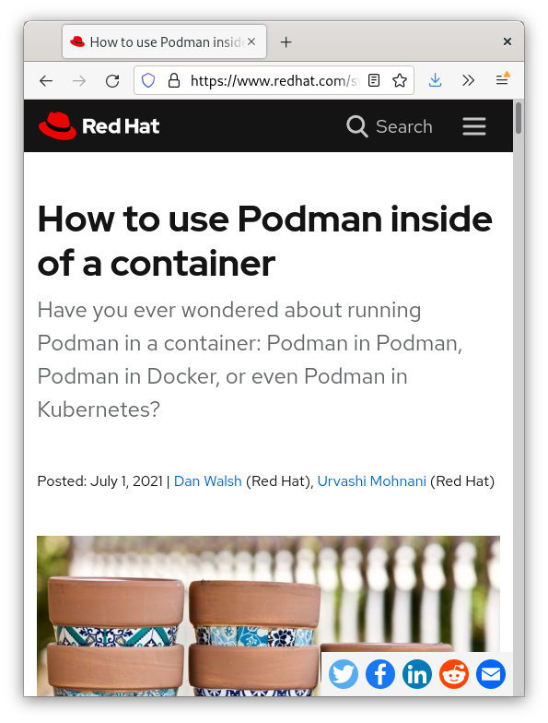
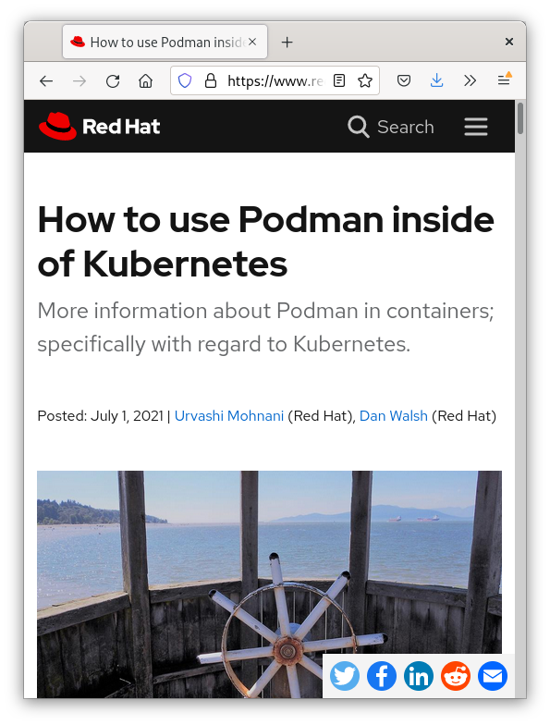
Podman multi-arch container image
Image to be used when running Podman inside of a container
quay.io/podman/stable
https://www.redhat.com/sysadmin/podman-inside-container
https://www.redhat.com/sysadmin/podman-inside-kubernetes

Slide 92
Podman Future
Support for WASM based Containers via WASM OCI Runtime

Slide 93
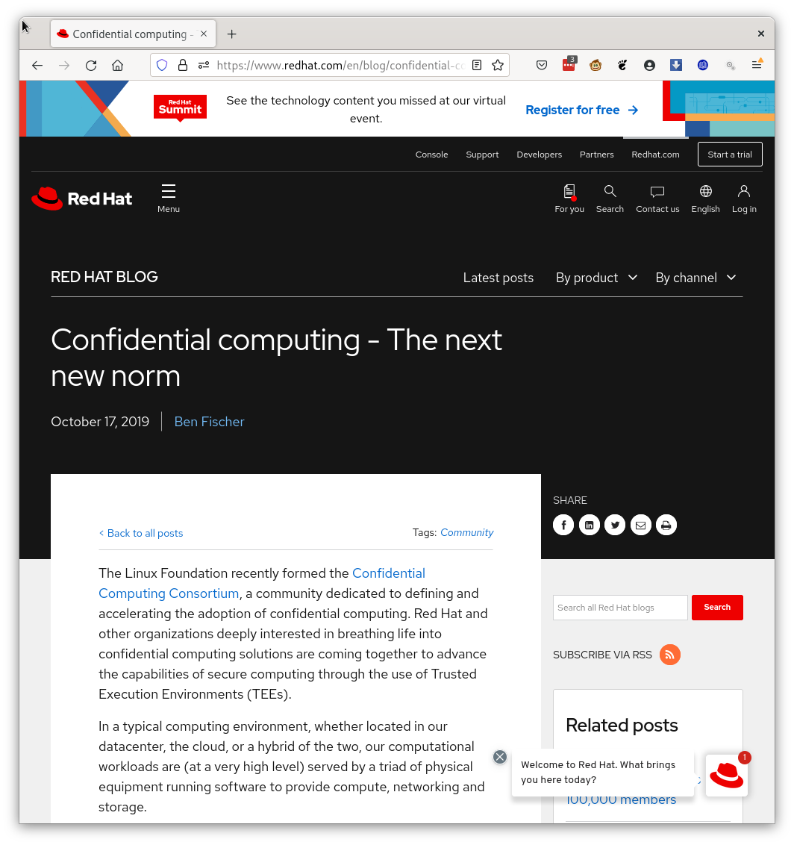
Podman Future
Confidential Computing
  Intel (SGX), AMD (SEV) and Arm companies adding security chips

Slide 94
Podman Confidential Containers
System proves it has not been hacked via trusted boot.
Provides verification key to accreditation server
Podman running within encryption envelope begins downloading app and data
Podman runs containers within KVM
Adminstrator (root) on the host can not examine container or its data.

Slide 95
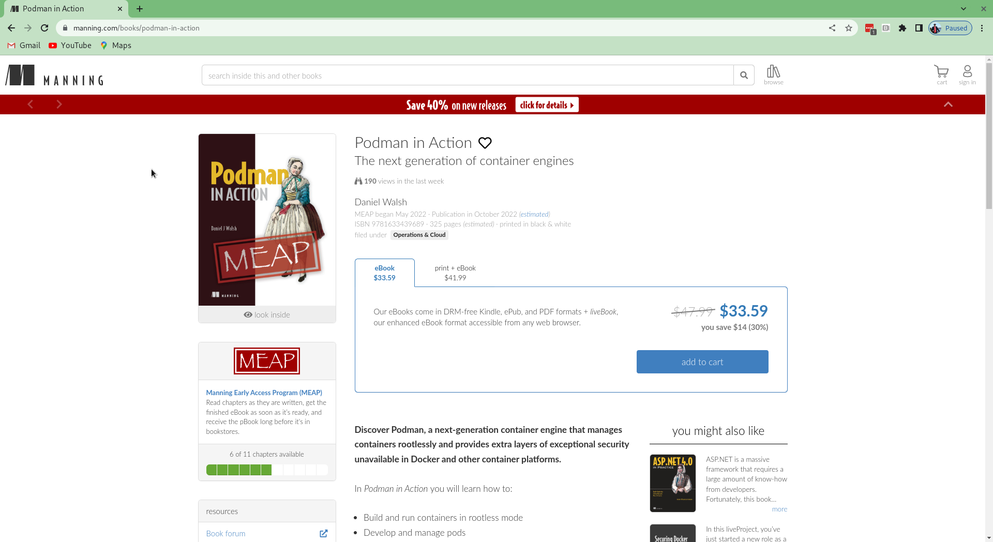
Shameless Plug: Podman in Action - By Daniel Walsh https://www.manning.com/books/podman-in-action

Slide 96

QUESTIONS

